Slide 1
FINAL PROJECT : CUSTOMER SEGMENTATION
By: Brianna Viñas
MIS: 64060-001-Fundamentals in Machine Learning
Dr. Murali Shanker
Final Project: Customer Segmentation
Fall 2021

Slide 2
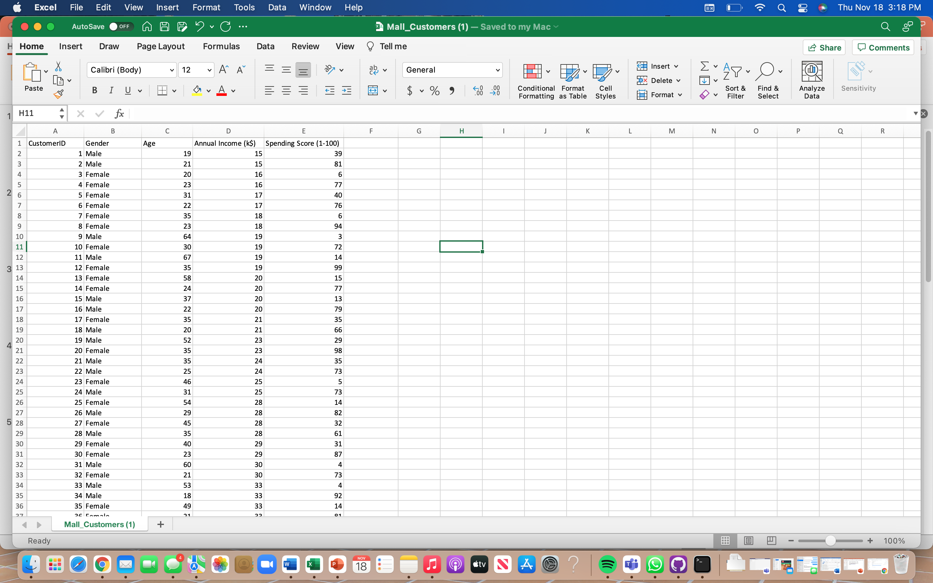
TOPIC USING REAL WORLD DATA: CUSTOMER SEGMENTATION
My topic will focus on clustering customers based on their purchase behavior.
Sources used for compiling my real word data:
https://www.kaggle.com/
Problem Statement:
Do annual incomes accurately reflect annual spending scores?
Intended to Show:
That annual incomes are not necessarily a predictor of annual spending scores.
Real-world data used for my final project

Slide 3
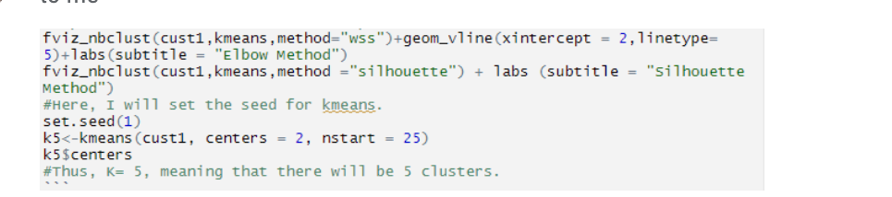
ALGORITHIM CHOSEN:
K-Means/Unsupervised Learning:
K-means is a clustering algorithm that tries to partition points into k sets (clusters) such that the points in each cluster tend to be near one another. Calculates the initial class means evenly distributed in the data space using a minimum distance technique without the use of labeling
Elbow Method:
Heuristic used in determining the number of clusters in a data set. The method consists of plotting the explained variation as a function of the number of clusters and picking the elbow of the curve as the number of clusters to use.
Silhouette Method:
Plot displays a measure of how close each point in one cluster is to points in the neighboring clusters and thus provides a way to assess parameters like number of clusters visually.

Slide 4
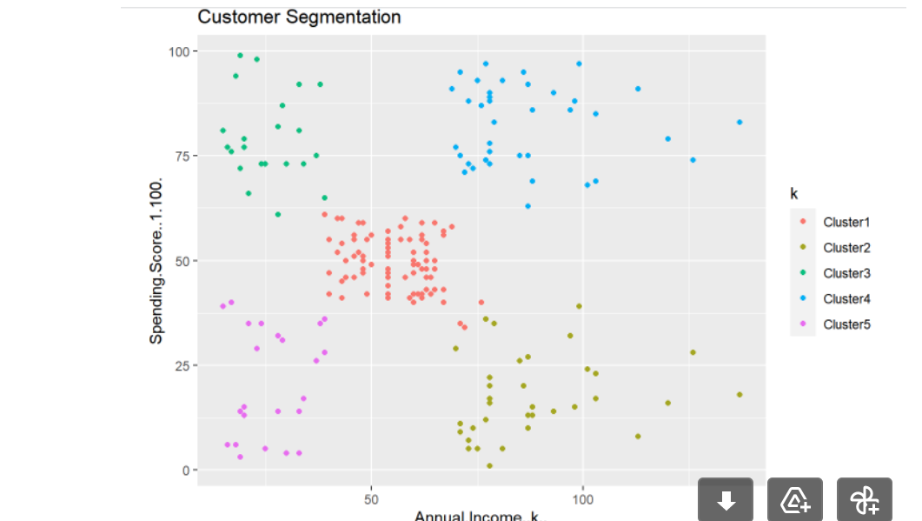
SUMMARY/CONCLUSION DRAWN:
Cluster # 1: Customers who earn a medium annual income and have a medium annual spending score.
Cluster # 2: Customers who earn a high annual income and have a low annual spending score.
Cluster # 3: Customers who earn a low annual income and have a high annual spending score.
Cluster # 4: Customers who earn a high annual income and have a high annual spending score.
Cluster #5: Customers who earn a low annual income and have a low annual spending score.

Slide 5
Thank You.
www.kent.edu

